Slide 1
Everything you and your patients should know about HPV vaccination
Rebecca B. Perkins MD, MSc
Assistant Professor of Obstetrics and Gynecology
Boston University School of Medicine/ Boston Medical Center
September 16th 2014

Slide 2
Presenter Disclosure Information
Rebecca B. Perkins MD MSc
Consultant | No relevant conflicts of interest to declare or relevant conflict
Grant Research/Support | No relevant conflicts of interest to declare or relevant conflict
Speaker’s Bureau | No relevant conflicts of interest to declare or relevant conflict
Major Stockholder | No relevant conflicts of interest to declare or relevant conflict
Other Financial or Material Interest | No relevant conflicts of interest to declare or relevant conflict
Off Label Use of Vaccines | Will be discussed, but in accordance with current ACIP recommendations

Slide 3
Questions for you (1)
1. Do you routinely see pre-teens and young adolescents (ages 10-14) in your clinical practice?
  a. Yes
  b. No
  c. Sometimes

Slide 4
Questions for you (2)
2. Do you routinely see middle/late adolescents and young adults (15-26) in your clinical practice?
  a. Yes
  b. No
  c. Sometimes

Slide 5
Objectives
Overview of HPV-related disease
HPV vaccine and recommendations
Vaccine safety, impact, and vaccination rates
Discuss common barriers in vaccine discussions with parents and evidence-based ways to overcome them

Slide 6
What is the morbidity from HPV?
3 million Americans seek medical care for HPV each year
33,000 develop HPV-related cancers
HPV currently causes more illness and death than all other vaccine-preventable diseases combined (except influenza)

Slide 7
Why do we vaccinate?
To prevent HPV-associated cancer
Current screening is NOT enough

Slide 8
Pap history in women diagnosed with cervical cancer
Pap smear within 3 years of cancer diagnosis | % women diagnosed with cervical cancer
None | 53%
Normal | 28%
Abnormal with f/u | 9%
Abnormal, no f/u | 4%
Sung et al, Cancer 2000; 88: 2283-9

Slide 9
Average Number of New HPV-Associated Cancers by Sex, in the United States, 2005-2009
Oropharynx
Jemal A et al. J Natl Cancer Inst 2013;105:175-201
Notes:
These data are from the Annual report to the Nation— published by 3 lead organizations on cancer surveillance –the American Cancer Society, the CDC, and the National Cancer Institute. This slide shows the average number of new human papillomavirus (HPV) –associated cancers overall, and by sex from 2005-2009.
Among women, the most common HPV cancer is cervical. Among males, the most common cancer was oropharyngeal.
An important point that isn’t shown on this slide: In addition to invasive cancers it is estimated that there are 1.4 million cervical disease or preinvasive cervical cancers and another 40,000 of the highest grade of anal, vulvar and vaginal precancers.

Slide 10
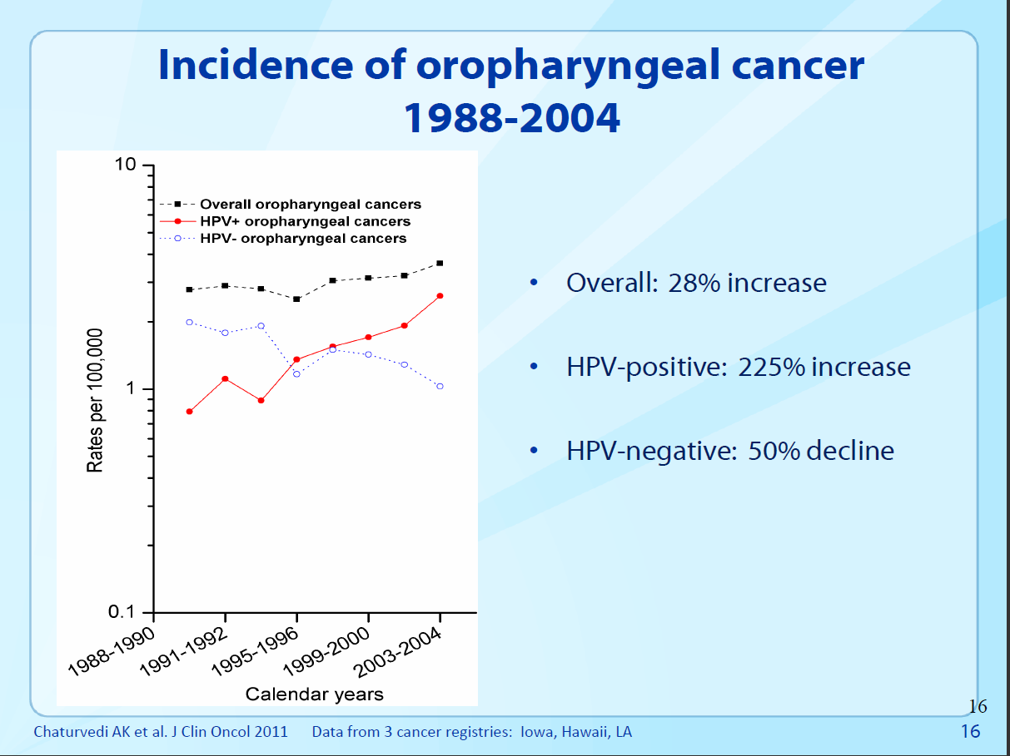
Risk factors for HPV+ and HPV- oropharyngeal cancers differ:
HPV+: sexual behavior, tobacco
HPV-: tobacco, alcohol
Survival from HPV+ and HPV- oropharyngeal cancers differs:
HPV+: 69% reduction in risk of death (after adjustment for age, when dxed, etc.)
Markowitz, ACIP, Oct 2011

Slide 11
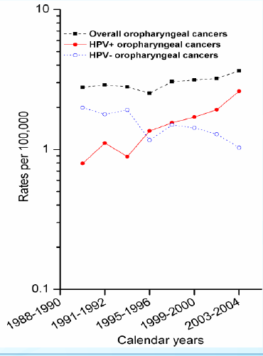
HPV-Associated Oropharyngeal Cancers
HPV+ cancers increased from 16.3% (1984) to 71.7% (2004)
HPV+ cancers increased by 225%, while HPV- cancers declined 50%
Chaturvedi, 2011, J Clin Oncol- data from SEER
Notes:
More oropharyngeal cancers that were previously thought to be caused by tobacco and/or alcohol use are now being identified as HPV-related cancers.
The number of oropharyngeal cancers diagnosed that are not caused by HPV have declined by half.

Slide 12
Why do we want to protect boys from HPV?
Oropharyngeal cancers more common in men
No screening test for oropharyngeal cancers
If trends continue, the annual number of HPV-positive oropharyngeal cancers is expected to surpass the annual number of cervical cancers by the year 2020

Slide 13
Without vaccination, annual burden of genital HPV in U.S. females: 3 million cases, $7 billion
10,846 new cases of cervical cancer
4,000 deaths
330,000 new cases of HSIL (CIN2/3)
1 million new cases of genital warts
1.4 million new cases of LSIL (CIN1)
American Cancer Society. 2008;. Schiffman Arch Pathol Lab Med. 2003; Koshiol
Sex Transm Dis. 2004; Insinga, Pharmacoeconomics, 2005
Notes:
Assessing the Annual Economic Burden of Preventing and Treating Anogenital Human Papillomavirus-Related Disease in the US: Analytic Framework and Review of the Literature
Authors: Insinga, Ralph P.¹; Dasbach, Erik J.¹; Elbasha, Elamin H.¹
Source: PharmacoEconomics, Volume 23, Number 11, 2005 , pp. 1107-1122(16)
Key Point
Human papillomavirus (HPV) infection is very common, but, in the majority of cases, has no clinical manifestation. Of all HPV-related conditions, cervical cancer is the most serious. However, most HPV-related morbidity is associated with cervical dysplasia or genital warts. Cervical dysplasia is caused by both oncogenic and nononcogenic types, and genital warts by nononcogenic types.
Background
The estimated annual incidence of low- and high-grade dysplasia in the United States is 1.4 million, and 330,000 cases, respectively.¹ There are an estimated 1 million new cases of genital warts occurring every year in the United States.² The American Cancer Society estimates that in 2006, 9,710 women in the United States will develop cervical cancer.³
More than 100 HPV types have been detected,⁴ with >80 types sequenced and classified.⁵ Approximately 30 to 40 of these types of HPV infect the genital tract.^{4,5} Of these, Types 16 and 18 cause about 70% of cervical cancer,⁶ at least 50% of all high-grade cervical dysplasia,⁷ and, along with HPV Types 6 and 11, approximately 35% of all low-grade cervical dysplasias.⁸ A study has shown that HPV 6 and 11 also cause 90% of anogenital warts.⁹
References
1. Schiffman M, Solomon D. Findings to date from the ASCUS-LSIL Triage Study (ALTS). Arch Pathol Lab Med. 2003;127:946–949.
2. Fleischer AB, Parrish CA, Glenn R, et al. Condylomata acuminata (genital warts): Patient demographics and treating physicians. Sex Transm Dis. 2001;28:643–647.
3. American Cancer Society. Cancer Facts and Figures 2006. Atlanta, Ga: American Cancer Society; 2006:4.
4.Schiffman M, Castle PE. Human papillomavirus: epidemiology and public health. Arch Pathol Lab Med. 2003;127:930–934.
5. Wiley DJ, Douglas J, Beutner K, et al. External genital warts: diagnosis, treatment, and prevention. Clin Infect Dis. 2002;35(suppl 2):S210–S224.
6. Muñoz N, Bosch FX, de Sanjosé S et al. Epidemiologic classification of human papillomavirus types associated with cervical cancer. N Engl J Med. 2003;348:518–527.
7. Clifford GM, Smith JS, Aguado T, et al. Comparison of HPV type distribution in high-grade cervical lesions and cervical cancer: a meta-analysis. Br J Cancer. 2003;89:101–105.
8. Clifford GM, Rana RK, Franceschi S, et al. Human papillomavirus genotype distribution in low-grade cervical lesions: comparison by geographic region and with cervical cancer. Cancer Epidemiol Biomarkers Prev. 2005;14:1157–1164.
9. Gissmann L, Wolnik L, Ikenberg H, Koldovsky U, Schnurch HG, zur Hausen H. Human papillomavirus types 6 and 11 DNA sequences in genital and laryngeal papillomas and in some cervical cancers. Proc Natl Acad Sci USA. 1983;80:560–563.

Slide 14
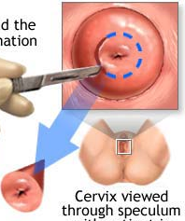
HPV infection causes preterm delivery
330,000 women undergo cone/
LEEP procedures every year
LEEP/HPV infection associated
with obstetric morbidity
  Preterm delivery
  Preterm rupture of membranes
  Low birth weight
  Long term developmental outcomes, neonatal intensive care costs
  HPV vaccination can prevent preterm deliveries!
Notes:
Treatment of cervical precancer and cancer can lead to many complications for women of childbearing age:
Cervical cancer is often treated by hysterectomy, leaving many young women unable to have any or additional children
High-grade (or severe) precancerous lesions often require treatment that can cervical imcompetance or cervical stenosis
Cervical incompetance can lead to preterm delivery and cervical stenosis can lead to birth complications- both of which lead to tremendous burden on the mother, infant and their family

Slide 15
HPV Vaccine
Recommendations, Safety, Impact, & Coverage Rates
Notes:
This next section will focus on HPV vaccine and the impact on HPV-related disease and cancer

Slide 16
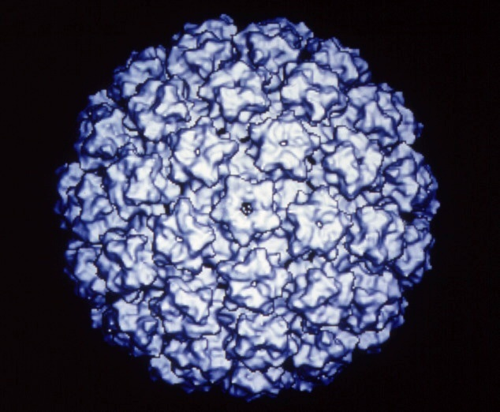
HPV Prophylactic Vaccines
Recombinant L1 capsid proteins that form “virus like” particles (VLP)
Non-infectious and non-oncogenic
Produce higher levels of neutralizing antibody than natural infection
HPV VLP
Notes:
HPV vaccines are made from virus-like particles that cannot cause infection with HPV or cause cancer. HPV vaccines produce a better immune response than an HPV infection.

Slide 17
ACIP HPV Vaccine Recommendations
Population |  | Recommendation
Females | 11-12 (as young as 9) | Routine vaccination with either HPV4 or HPV2
 | 13-26 | Routine catch-up vaccination either HPV4 or HPV2*
Males | 11-12 (as young as 9) | Routine vaccination with HPV4
 | 13-21 | Catch-up vaccination HPV4
 | 22-26 | Permissive recommendation HPV4
MSM & HIV+ Males | 22-26 | Catch-up vaccination HPV4
* Irrespective of history of abnormal Pap, HPV, genital warts
MMWR, May 28 2010; 59(20):626-629 , 630-632
MMWR , December 23 2011; 60(50);1705-1708
Notes:
17
ACIP: Advisory Committee on Immunization Practices
Other vaccines for the same pre-teen age group:
Tdap: tetanus, diphtheria, acellular pertussis
Meningitis (Menactra)
Booster for Varicella
Influenza (seasonal)

Slide 18
Is it safe?
Does it work?
Will it change my child’s behavior?
Parents and adolescents want to know…

Slide 19
HPV Vaccine Safety
Most common adverse events reported were considered mild
For serious adverse events reported, no unusual pattern or clustering that would suggest that the events were caused by the HPV vaccine
These findings are similar to the safety reviews of MCV4 and Tdap vaccines
57 million doses of HPV vaccine distributed in US since 2006
100 million doses worldwide (Europe, Australia)
Notes:
More than 175 million doses of HPV vaccine have been distributed worldwide and 57 million doses have been distributed in the United States. In the seven years of HPV vaccine safety studies and monitoring that have been conducted since the vaccine was licensed, no serious safety concerns have been identified. Reports to the Vaccine Adverse Event Reporting System (VAERS) have decreased each year since 2008.

Slide 20
HPV vaccine long-term safety data
Kaiser-Permanente: 190,000 females who received ≥ 1 dose of HPV vaccine August 2006 and March 2008
No increase in emergency room visits, hospitalizations, or any of 200 categories of illnesses
Karolinska Institute: Register based cohort study, Denmark and Sweden, October 2006 to December 2010.
997,585 girls aged 10-17, among whom 296,826 received a total of 696,420 qHPV vaccine doses
No increase in auto-immune disease, thromboembolic disease, neurologic disease
Arnheim-Dahlström, BMJ, Oct 2013
Klein NP, Archives of Pediatrics and Adolescent Medicine Oct 2012

Slide 21
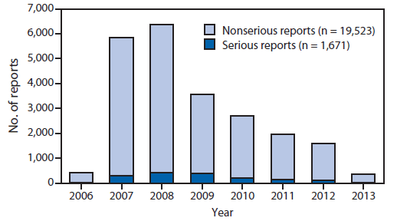
Serious and nonserious reports of adverse events after administration of HPV4 vaccine in females, by year — Vaccine Adverse Event Reporting System, United States, June 2006–March 2013

Slide 22
HPV Vaccine Impact: US
33% of teens are fully vaccinated
56% decline in HPV 6/11/16/18 in girls age 14-19
20% decrease in all CIN2/3 among 21-24 year olds
Substantial decrease in genital warts among female military under age 26 between 2007 to 2010
Garland et al, Prev Med 2011; Ali et al, BMJ 2013; Markowitz JID 2013; Niccolai, Cancer Epidemiol Biomarkers Prev 2013; Nsouli-Maktabi MSMR 2013
Notes:
Australia has high HPV vaccine coverage and has seen declines prevalence of HPV infections, pre-cancerous lesions, and genital warts in young women
HPV vaccine is only recommended for girls in Australia, yet they have seen a decline in genital warts in young men, which shows that there has been a decrease in transmission of HPV

Slide 23
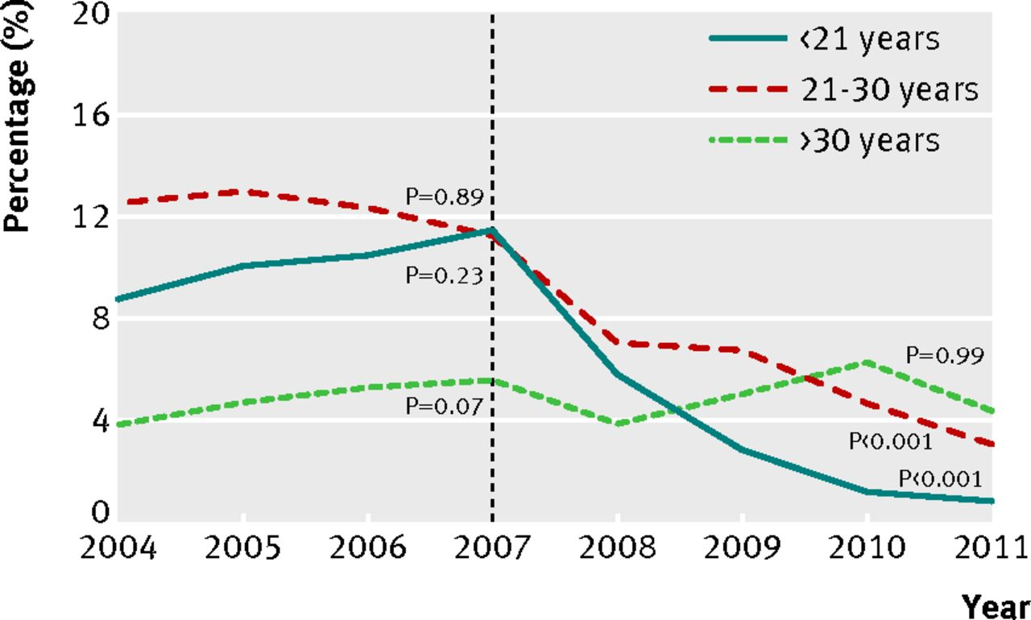
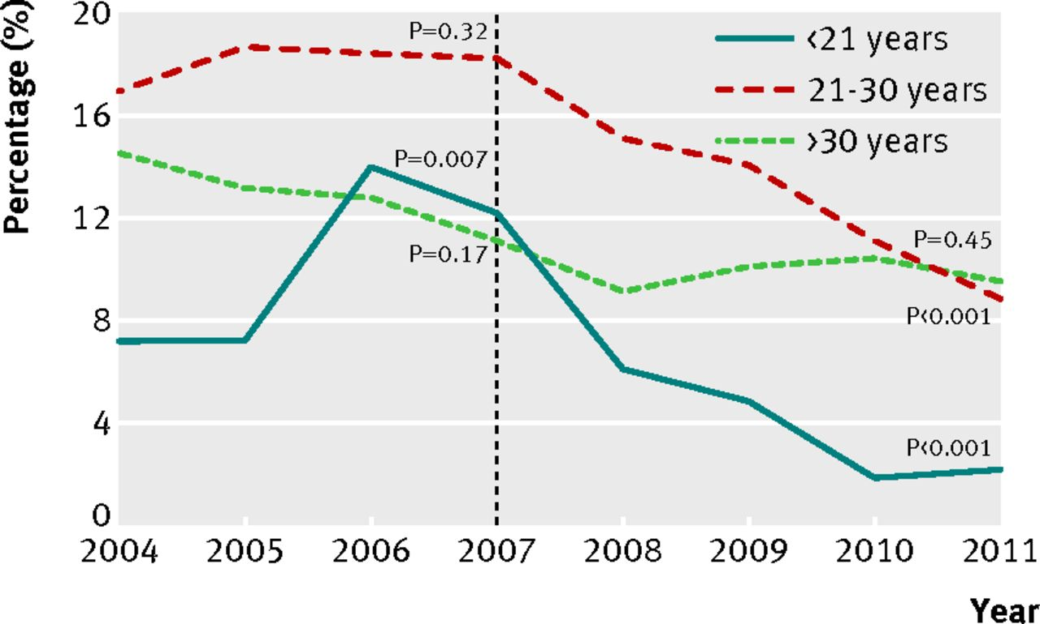
Genital warts in Australia 2004-11
70% vaccination rate
Women Men
51% decline
73% decline
93% decline
82% decline
Ali H et al. BMJ 2013;346:bmj.f2032
©2013 by British Medical Journal Publishing Group
Notes:
Fig 1 Proportion of Australian born women diagnosed as having genital warts at first visit, by age group, 2004-11

Slide 24
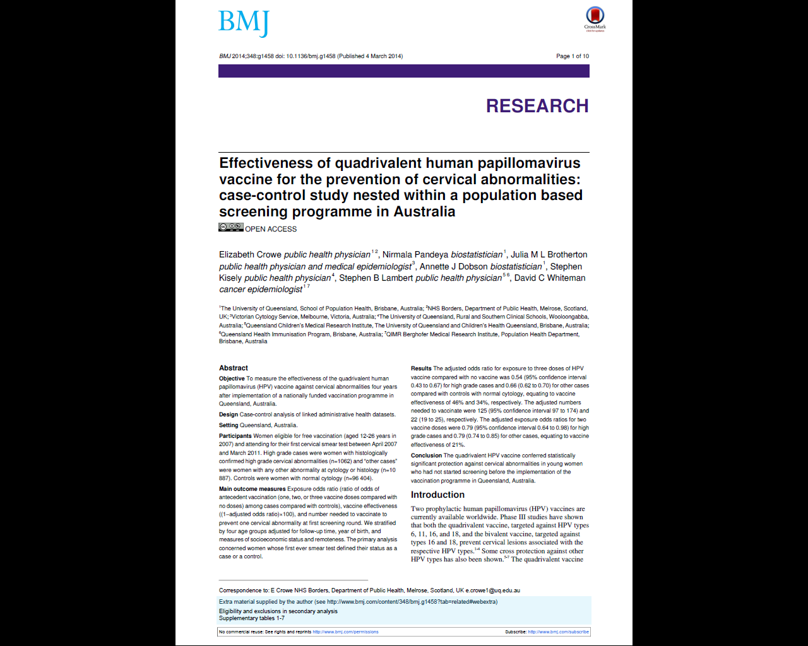
46% effectiveness against high-grade cervical lesions
Efficacy exceeds trial data
Crowe E et al. BMJ 2014;348:bmj.g1458
©2013 by British Medical Journal Publishing Group

Slide 25
Extrapolating the prior pyramid with projections of vaccine efficacy based on Australian data
Cervical cancer
46% reduction in CIN2/3 requiring LEEP*
85% reduction in genital warts
35% reduction in CIN1
Notes:
Key Point
Human papillomavirus (HPV) infection is very common, but, in the majority of cases, has no clinical manifestation. Of all HPV-related conditions, cervical cancer is the most serious. However, most HPV-related morbidity is associated with cervical dysplasia or genital warts. Cervical dysplasia is caused by both oncogenic and nononcogenic types, and genital warts by nononcogenic types.
Background
The estimated annual incidence of low- and high-grade dysplasia in the United States is 1.4 million, and 330,000 cases, respectively.¹ There are an estimated 1 million new cases of genital warts occurring every year in the United States.² The American Cancer Society estimates that in 2006, 9,710 women in the United States will develop cervical cancer.³
More than 100 HPV types have been detected,⁴ with >80 types sequenced and classified.⁵ Approximately 30 to 40 of these types of HPV infect the genital tract.^{4,5} Of these, Types 16 and 18 cause about 70% of cervical cancer,⁶ at least 50% of all high-grade cervical dysplasia,⁷ and, along with HPV Types 6 and 11, approximately 35% of all low-grade cervical dysplasias.⁸ A study has shown that HPV 6 and 11 also cause 90% of anogenital warts.⁹
References
1. Schiffman M, Solomon D. Findings to date from the ASCUS-LSIL Triage Study (ALTS). Arch Pathol Lab Med. 2003;127:946–949.
2. Fleischer AB, Parrish CA, Glenn R, et al. Condylomata acuminata (genital warts): Patient demographics and treating physicians. Sex Transm Dis. 2001;28:643–647.
3. American Cancer Society. Cancer Facts and Figures 2006. Atlanta, Ga: American Cancer Society; 2006:4.
4.Schiffman M, Castle PE. Human papillomavirus: epidemiology and public health. Arch Pathol Lab Med. 2003;127:930–934.
5. Wiley DJ, Douglas J, Beutner K, et al. External genital warts: diagnosis, treatment, and prevention. Clin Infect Dis. 2002;35(suppl 2):S210–S224.
6. Muñoz N, Bosch FX, de Sanjosé S et al. Epidemiologic classification of human papillomavirus types associated with cervical cancer. N Engl J Med. 2003;348:518–527.
7. Clifford GM, Smith JS, Aguado T, et al. Comparison of HPV type distribution in high-grade cervical lesions and cervical cancer: a meta-analysis. Br J Cancer. 2003;89:101–105.
8. Clifford GM, Rana RK, Franceschi S, et al. Human papillomavirus genotype distribution in low-grade cervical lesions: comparison by geographic region and with cervical cancer. Cancer Epidemiol Biomarkers Prev. 2005;14:1157–1164.
9. Gissmann L, Wolnik L, Ikenberg H, Koldovsky U, Schnurch HG, zur Hausen H. Human papillomavirus types 6 and 11 DNA sequences in genital and laryngeal papillomas and in some cervical cancers. Proc Natl Acad Sci USA. 1983;80:560–563.

Slide 26
Having sex gives you HPV, but getting an HPV vaccine does not make you have sex!

Slide 27
HPV Transmission
80% of people will be infected with HPV
Most common route is sexual intercourse
  genital-genital, anal-genital, oral-genital, manual-genital
Nearly 50% of high school students have already engaged in sexual (vaginal-penile) intercourse
  1/3 of 9th graders and 2/3 of 12th graders have engaged in sexual intercourse
  24% of high school seniors have had sexual intercourse with 4 or more partners
Jemal A et al. J Natl Cancer Inst 2013;105:175-201
Notes:
HPV is transmitted through skin-to-skin contact through vaginal, anal, or oral intercourse. Condoms do not completely stop transmission of HPV.
This data demonstrates how young someone can be exposed to HPV

Slide 28
HPV is found in virgins
Study examined the frequency of vaginal HPV and the association with non-coital sexual behavior in longitudinally followed cohort of adolescent women without prior vaginal intercourse
HPV was detected in 46% of women prior to first vaginal sex
70% of these women reported non-coital behaviors that may in part explain genital transmission
Shew, J Infect Dis. 2012
Notes:
Even if a teen isn’t having sex, they may be engaging in behaviors that can expose them to HPV. Even girls who reported never having sexual intercourse still had HPV infection.

Slide 29
Rapid acquisition of HPV in following sexual debut
Study of 18-23 year-old males (n=240)
Partridge, JID 2007
Notes:
29
This slide shows how quickly HPV infection occurs after first intercourse.
Genital HPV infection occurs frequently in women within 1 year of their first male sex partner.
Some women acquired genital HPV infection prior to having vaginal intercourse, suggesting that they may have had nonpenetrative sexual contact.
Young women are at high risk of acquiring HPV infection from her first male sex partner; the risk is increased by the partner’s prior sexual experience.

Slide 30
HPV may never go away
Infection remains dormant for decades, then reactivates later in life as immune system declines
Risk of HPV infection among women 50+ was associated with total lifetime partners but not new partners.
Conclusion: “Reactivation risk may increase around age 50 years and contribute to a larger fraction of HPV detection at older ages, compared with new acquisition.”
85% of incident infections occurred during periods of abstinence of monogamy, and were associated with lifetime number of sexual partners
Gravitt, JID 2013; Rostich Cancer Res 2012

Slide 31
Receiving HPV Vaccine Does Not Increase Promiscuity
National Survey of Family Growth n=1243 15-24 yo females
  HPV vaccination NOT associated with:
      Being sexually active
      Number of sexual partners
  HPV vaccination was associated with:
      More consistent condom use among 15-19 year olds (AOR=3.0, “always” wearing condom)
Kaiser Permanente Center for Health Research n=1398 11-12 yo girls in 2006, 30% of whom were vaccinated, followed thru 2010
  No difference in markers of sexual activity including pregnancies, counseling on contraceptives, and testing for or diagnoses of sexually transmitted diseases
Liddon NC, Am J Prev Med 2012;42:44
Bednarczyk RA, Pediatrics 2012;130:798

Slide 32
Why aren’t we vaccinating more?
Understanding missed opportunities

Slide 33
Questions for you (3)
3. What proportion of high school students have had one dose of the meningitis vaccine?
  a. 25%
  b. 50%
  c. 75%

Slide 34
Questions for you (4)
4. What proportion of female high school students have had at least one dose of HPV vaccine?
  a. 25%
  b. 50%
  c. 75%

Slide 35
US behind other nations in uptake of 3 doses HPV vaccine
Australia UK Canada Netherlands USA
Brotherton, Lancet 2011; Cuzick BJC 2010; Ogilvie et al., 2010; Marc et al., 2010, NIS-Teen 2011
Notes:
The U.S. lags behind in vaccine coverge compared with other countries.
Not shown in this slide is HPV vaccine coverage for Rwanda. Before 2011, neither cervical cancer screening nor HPV vaccination was available in public health facilities in Rwanda. The First Lady of Rwanda worked with the public health system and with vaccine manufacturers to create a HPV vaccine program. On 26 and 27 April 2011, 93,888 Rwandan girls in primary grade six received their first shot of Gardasil with no out-of-pocket payment. This was done in a 2-day school-based vaccination program with 3rd day following up with girls not enrolled in school. This was repeated for the second two doses. The program’s first round achieved 95.04% coverage, the second 93.90% and the third, 93.23%. Currently HPV vaccine coverage for Rwanda is 93%.

Slide 36
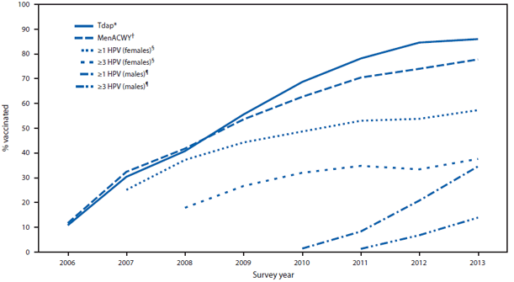
National Estimated Vaccination Coverage Levels among Adolescents 13-17 Years,
National Immunization Survey-Teen, 2006-2013
Tdap: tetanus, diphtheria, acellular pertussis vaccine.
MCV4: meningococcal conjugate vaccine
HPV: human papillomavirus vaccine
Notes:
Data from the 2012 National Immunization Survey-Teen (NIS-Teen) show that no progress has been
made in HPV vaccination coverage in girls since last year. Between 2007 and 2011, vaccination coverage
significantly increased each year for all doses, though rates lagged behind those of other recommended
vaccines for teens. From 2011 and 2012, there were no statistically significant changes in coverage. The
percentage of girls initiating the HPV vaccine series did not improve. The number of girls receiving all
three recommended doses of HPV vaccine failed to improve as well.

Slide 37
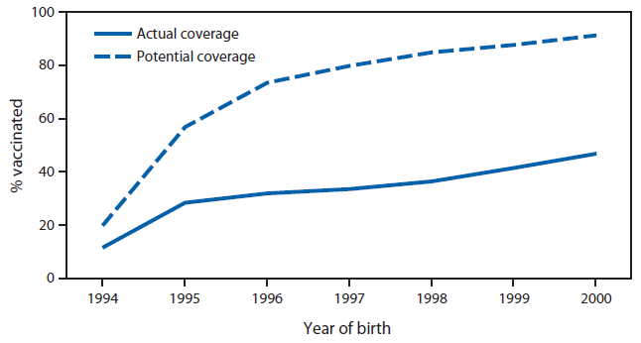
Actual and Achievable Vaccination Coverage if Missed Opportunities
Were Eliminated: Adolescents 13-17 Years, NIS-Teen 2013
Missed opportunity: Encounter when some, but not all ACIP-recommended vaccines are given.
Sotkley, MMWR 2014.

Slide 38
Strength of HPV Vaccine Recommendation for Female Patients, Pediatricians and
Family Physicians (N=609)
Allison et al. https://cdc.confex.com/cdc/nic2011/webprogram/Paper25181.html
Notes:
When we have studied HPV vaccination practices among physicians we see that providers are less likely to recommend the HPV vaccine to their younger adolescent patients. This slide shows results of a national survey of pediatricians and family physicians. Only 51% of providers strongly recommend HPV for their female patients 11 to 12 years old as shown by the top light blue bar. And the percent who strongly recommend the vaccine increases with patient age.

Slide 39
Delay more common than refusal
Providers introduce HPV vaccination at 11 but do not recommend it strongly
“I’d honestly say it’s rare that I spend more than 20 seconds on it at 11… So few 11 year olds are physically mature to be sexually active that it’s, I find it’s almost sort of an awkward conversation.”
Parents do not understand the reason to vaccinate at early
“I thought that it didn’t really make any difference as long as they had the three vaccines before their 20’s.”
Perkins et al, Pediatrics, 2014
Notes:
Australia has high HPV vaccine coverage and has seen declines prevalence of HPV infections, pre-cancerous lesions, and genital warts in young women
HPV vaccine is only recommended for girls in Australia, yet they have seen a decline in genital warts in young men, which shows that there has been a decrease in transmission of HPV

Slide 40
Uptake of 3 doses HPV vaccine by age
13 14 15 16 17
NIS-Teen 2012
Notes:
The U.S. lags behind in vaccine coverge compared with other countries.
Not shown in this slide is HPV vaccine coverage for Rwanda. Before 2011, neither cervical cancer screening nor HPV vaccination was available in public health facilities in Rwanda. The First Lady of Rwanda worked with the public health system and with vaccine manufacturers to create a HPV vaccine program. On 26 and 27 April 2011, 93,888 Rwandan girls in primary grade six received their first shot of Gardasil with no out-of-pocket payment. This was done in a 2-day school-based vaccination program with 3rd day following up with girls not enrolled in school. This was repeated for the second two doses. The program’s first round achieved 95.04% coverage, the second 93.90% and the third, 93.23%. Currently HPV vaccine coverage for Rwanda is 93%.

Slide 41
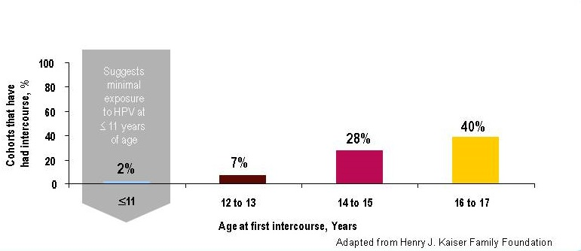
Prevalence of sexual activity by age
82%
67%
35%
18 to 24
Markowitz MMWR 2007;
Holl Henry J Kaiser Found 2003;
Mosher Adv Data 2006
Notes:
HPV vaccines should be given prior to exposure to HPV. There is no reason to wait until a teen is having sex. We don’t wait until exposure occurs to give any other routinely recommended vaccine- we give the vaccine before we think exposure is likely to occur to ensure the best protection.

Slide 42
The younger the better, but better late than never
Vaccine 50% more effective when vaccination occurs age 15-17 compared with over age 18
  46% vs. 35% reduction in HSIL
  35% vs. 0% reduction in LSIL
No protection if evidence of infection prior to vaccination (i.e. abnormal pap)
Mahmud et al, J Clin Onc, Jan 2014

Slide 43
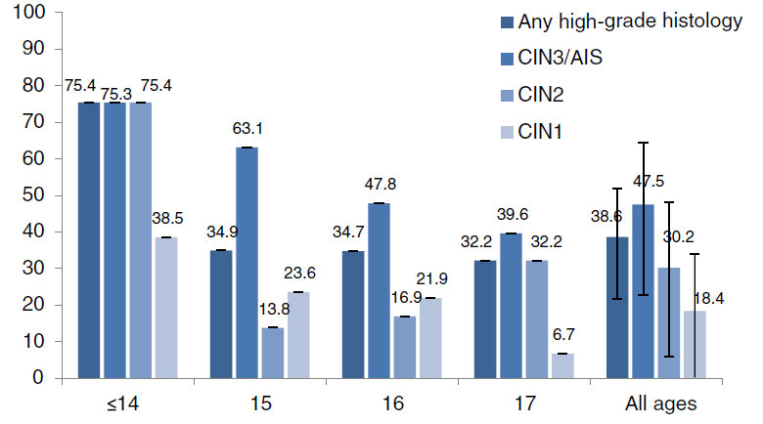
HPV vaccine effectiveness for cervical abnormalities in Australia
Gertig DM, BMC Med 2013
Notes:
HPV vaccination prevented 75% of cervical pre-cancer when given priot to age 14, and efficacy declined with age because more girls were already infected when they were vaccinated.

Slide 44
HPV vaccination for ages 18-26
<20% of eligible females vaccinated
National Longitudinal Study of Adolescent Health (n=3276)
  9% of women positive for HPV 6,11,16 or 18
  0% of women positive for all 4 types
Provider recommendation most influential factor in this age group
Price Cancer 2011; Dempsey Vaccine 2008 and 2011; Rosenthal, Vaccine, 2010

Slide 45
Top 5 reasons for not vaccinating boys and girls, NIS-Teen 2013
* Not mutually exclusive.
** Did not know much about HPV or HPV vaccine.
Notes:
This slide shows the responses that parents gave when asked why they would not be getting the HPV vaccine for their son or daughter in the next year.
Three reasons that parents provided—lack of knowledge, not needed, and not sexually active—all demonstrate a lack of understanding on the part of the parent, especially why it is important to vaccinate at ages 11 or 12. Parents need to be told that HPV vaccine is cancer prevention and that it must be given prior to exposure.
Safety concerns can be alleviated by sharing the tremendous amount of data before and after the vaccine was licensed that demonstrate that HPV vaccine is safe.

Slide 46
Framing makes a difference
BAD
Provider: Meghan and Mark are due for some shots today: Tdap and the meningococcal vaccine. There is also the HPV vaccine…
- Vaccine perceived as different, optional, unimportant
GOOD
Provider: Meghan and Mark are due for some shots today: HPV, meningococcal vaccine, and Tdap.
Presumption of vaccine uptake
Vaccination percieved as normative, important
CATCH UP
Provider: I see that Meghan and Mark haven’t gotten their HPV vaccines yet. We should definitely start that today!
- Presumption of vaccine uptake, conveys message of importance
Opel et al 2014
Notes:
Based on the previous slides, the scenario has been rewritten to reflect the clinicians new knowledge. How does this feel to you? Would you do anything differently?

Slide 47
Each adolescent visit may be your last chance to vaccinate!
30% of adolescents never present for preventive care
1 in 15 adolescent visits is for preventive care.
Preventive visits decline after age 13
Late adolescent males had the fewest preventive visits - 6% of all visits
Late adolescent females had the most visits, but only 3% were for preventive care.
Early adolescents (11-14 years old) had 3 times more preventive visits than late adolescents.
Rand et al. Arch Pediatr Adolesc Med
Notes:
77. Rand CM, Shone LP, Albertin C et al. National health care visit patterns of adolescents: implications for
delivery of new adolescent vaccines. Arch Pediatr Adolesc Med. 2007 Mar;161(3):252-9.

Slide 48
Addressing all concerns in 45 seconds
Provider: Meghan and Mark are due for their HPV vaccine.
Parent: Why do they need an HPV vaccine?
Provider: The HPV vaccine will help protect them from cancer caused by HPV infection. We know that HPV infection is dangerous– 33,000 people in the US get cancer from HPV every year. And we know that the HPV vaccine is safe– over 100 million doses have been given and there haven’t been any serious side effects.
Parent: I don’t think they need that yet…
Provider: Vaccines only work if they’re given before exposure– we never wait until a child is at risk to give any recommended vaccines. HPV vaccine is also given as early as possible because it produces a better immune response in younger adolescents. That’s why it is so important to start the shots now and finish all 3 of them in the next 6 months.
Notes:
Based on the previous slides, the scenario has been rewritten to reflect the clinicians new knowledge. How does this feel to you? Would you do anything differently?

Slide 49
Parents weigh risks and benefits
Parents who declined vaccine and those who accepted had similar concerns
Both had concerns related to safety and sexuality but accepters weighed cancer prevention more heavily
Most parents also believed their daughters would at some point be at risk for STIs
Perkins et al, Clin Peds 2013; Perkins et al J of Peds 2010;
Perkins et al J Healthcare Poor Underserved 2013
Notes:
Many clinicians perceive questions as parents as vaccine hesitancy. But is this parents really hesitant? How could the parent’s questions been answered?

Slide 50
Providers overestimate parent’s concerns
“From what I understand the vaccine is safe, efficacious and I’d be a fool and also have amnesia to believe that high schoolers do not engage in unwise sexual practices at times.” —Father of a 12 year-old
55-90% of parents and adolescents will follow provider recommendations
Many adolescents seeking contraception will be unvaccinated– family planners are very important vaccinators
Perkins et al, published abstract JAH, Brewer 2007, Prev Med
Notes:
Many clinicians perceive questions as parents as vaccine hesitancy. But is this parents really hesitant? How could the parent’s questions been answered?

Slide 51
Discuss HPV vaccination when you screen moms for cervical cancer
One doctor says:
“In your experience with your health right now, you may be screened for cervical cancer by means of a pap smear… because cervical cancer can obviously be something that can be life-threatening but if caught soon, it can be taken care of, and this is how your health is impacted by this virus right now. Well, children now have the option of getting the HPV vaccine which is actually very effective at reducing the risk for contracting that same virus.”

Slide 52
HPV is common and dangerous
3 million Americans seek medical treatment for HPV-related disease every year
11,000 women every year get cervical cancer– 30% of them were screened on time
21,000 men and women every year get HPV-related cancers for which there are no screening tests
We can do better
Notes:
Even if a teen isn’t having sex, they may be engaging in behaviors that can expose them to HPV. Even girls who reported never having sexual intercourse still had HPV infection.

Slide 53
HPV vaccination IS high quality care
75% reduction in cervical pre-cancer BEFORE AGE 14
  35% reduction after age 14
85% reduction in genital warts
100 million doses have been given worldwide with no evidence of serious side effects
A strong recommendation is critical
Notes:
Even if a teen isn’t having sex, they may be engaging in behaviors that can expose them to HPV. Even girls who reported never having sexual intercourse still had HPV infection.

Slide 54
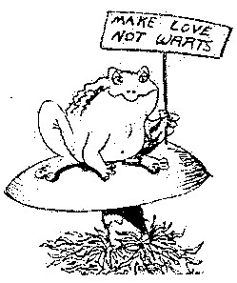
Conclusions
Vaccinating all your patients with HPV vaccines will save lives and improve health
For more information,
including free resources for providers and patients:
cdc.gov/vaccines/teens

